Slide 1



SMART DUSTBIN
Presented by,
Pranavakumar S Tingare ( 1712060)
Zoheb mir (1822004)
Pratik Lodha ( 1822015)
Under the guidance of:-
Prof. Amrita Naiksatam

Slide 2
INTRODUCTION
Fully Automated Smart Dustbin with IOT for monitoring.
It will Segregate dry and wet waste & inform about level of garbage collected.
It will identify the harmful substances present.

Slide 3
FEATURES
Smart, sensor based dustbin will judge level of waste in it and send the message directly to the authorities.
It can sense all type of materials as dry or wet/moistured material.
It emphasizes on DIGITAL INDIA.
It tracks waste transport trucks using GSM and IOT
The system is simple.
Any equipment or part of the system is easily replaceable with new part, if needed.

Slide 4
LITERATURE REVIEW
SR NO. | Reference | Description
1. | "IOT Based Garbage Monitoring and Sorting System",Ms. Pranjali P. Channe, International Research Journal of Engineering and Technology (IRJET). | This project segregates wet and dry garbage using moisture sensor, it continuously monitors the level of garbage box by using ultrasonic sensor, it checks for harmful substances using gas sensor and all this monitored using Iot.
2. | "IoT Based Smart Garbage and Waste Collection Bin",S.S.Navghane, International Journal of Advanced Research in Electronics and Communication Engineering (IJARECE) Volume 5, Issue 5, May 2016. | This project measures the level using three IR sensor and weight of the garbage in the trash can and piezo sensor and this can be monitored using IOT.
3. | "Smart Garbage Monitoring System using Internet of Things (IOT)”,Prof. Dr. Sandeep M. Chaware , International Journal of Innovative Research in Electrical, Electronics, Instrumentation and Control Engineering (IJIREEICE). | This project IOT Garbage Monitoring system monitors the garbage bins and informs about the level of garbage collected in the garbage bins via a web page by using ultrasonic sensors, Arduino family microcontroller, LCD screen, Wi-Fi modem for sending data and a buzzer.
4. | “Smart Dustbin”, B.Rajapandian, International Journal of Engineering and Advanced Technology (IJEAT). | In this project the Ultrasonic sensor senses the level of the garbage in the dustbin and in some cases the level is not full but it causes some bad smell & it is detected by using gas sensor and it will send message to the authorities using ARDUINO, GPS and GSM.

Slide 5
BLOCK DIAGRAM
POWER SUPPLY
MOTOR
DRIVER 1
H
MOTOR 1
ULTRASONIC SENSOR 1
MOTOR
DRIVER 2
H
MOTOR 2
ULTRASONIC SENSOR2
GAS SENSOR
ARDUINO
UNO
WIFI
MODULE
PIR
INTERNET
MOISTURE SENSOR

Slide 6
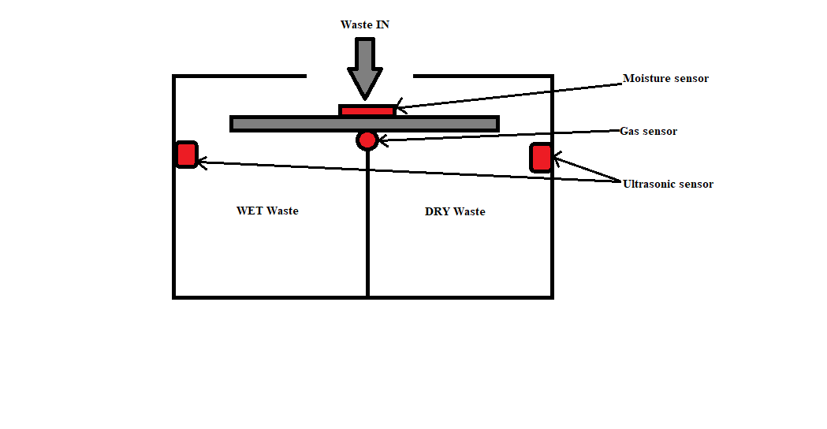
CONSTRUCTIONAL DETAILS

Slide 7
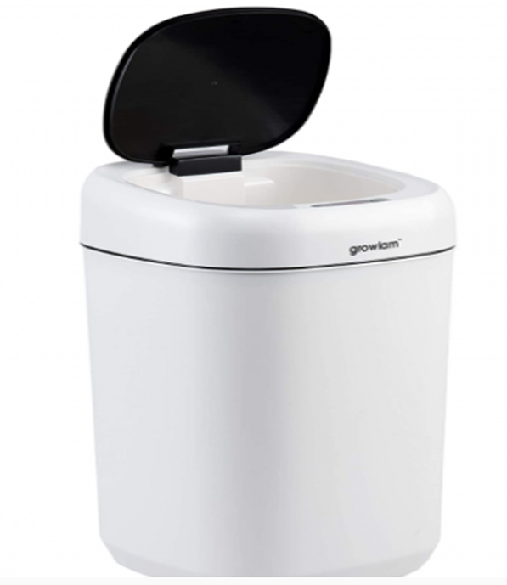
CURRENTLY AVAILABLE PRODUCTS
Growlam Automatic Waste Bin with Motion Sensor.

Slide 8
HARDWARE REQUIREMENTS
Components | Quantity
Arduino Uno | 1
ESP8266 | 1
PIR Sensor | 1
Ultrasonic Sensor(HC-SR04) | 2
Gas Sensor(MQ2) | 1
Moisture Sensor | 1
Stepper Motor | 2
ULN2003 | 2

Slide 9
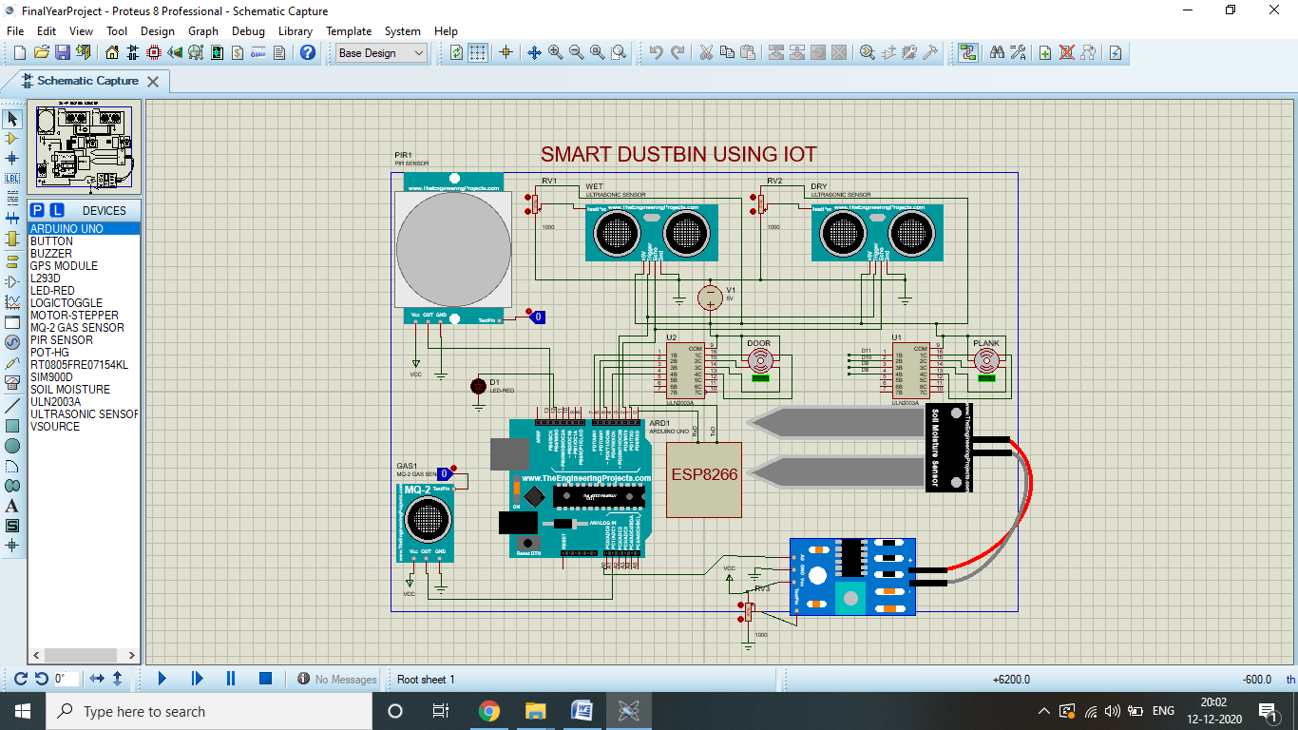
CIRCUIT DIAGRAM

Slide 10
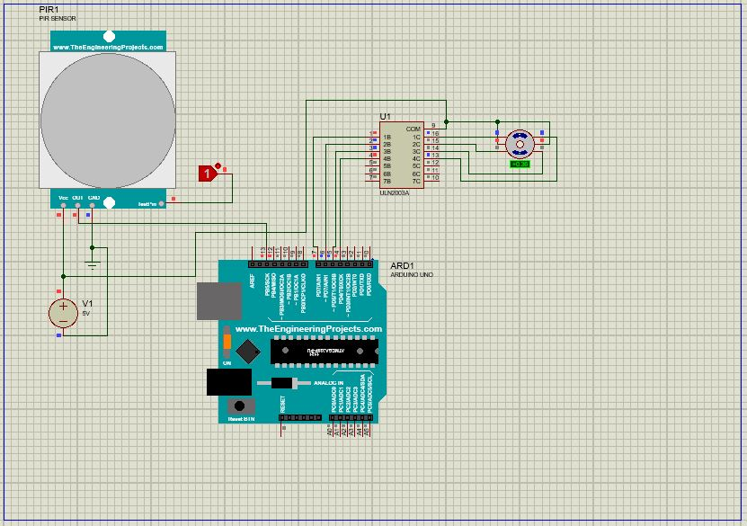
SIMULATION OF PIR SENSOR & STEPPER MOTOR

Slide 11
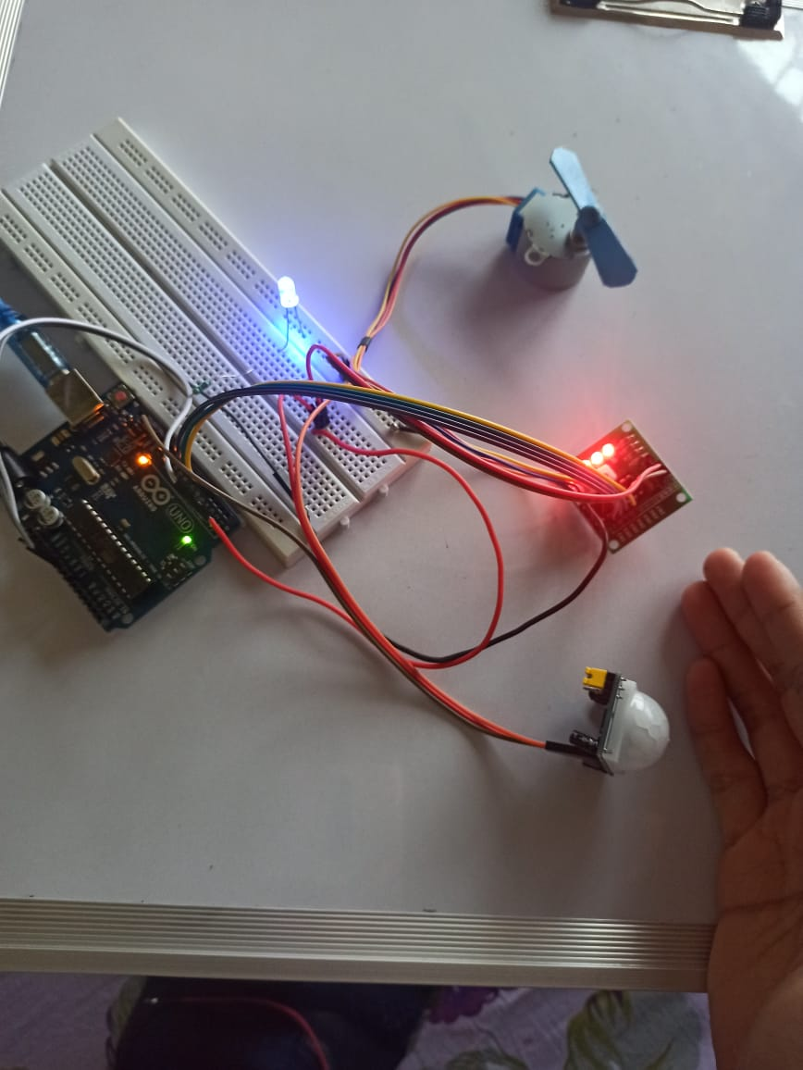
HARDWARE TESTING OF PIR & STEPPER MOTOR

Slide 12
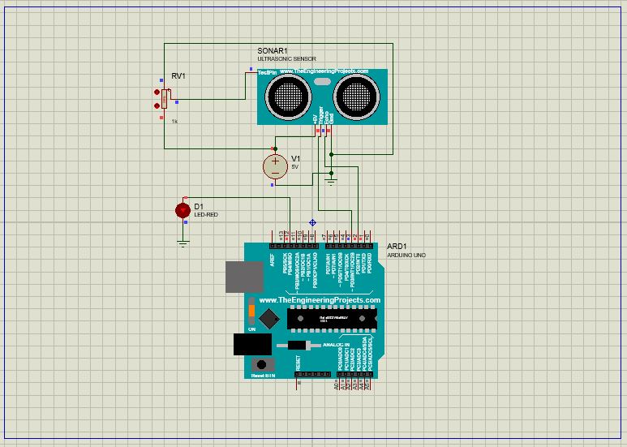
SIMULATION OF ULTRASONIC SENSOR

Slide 13
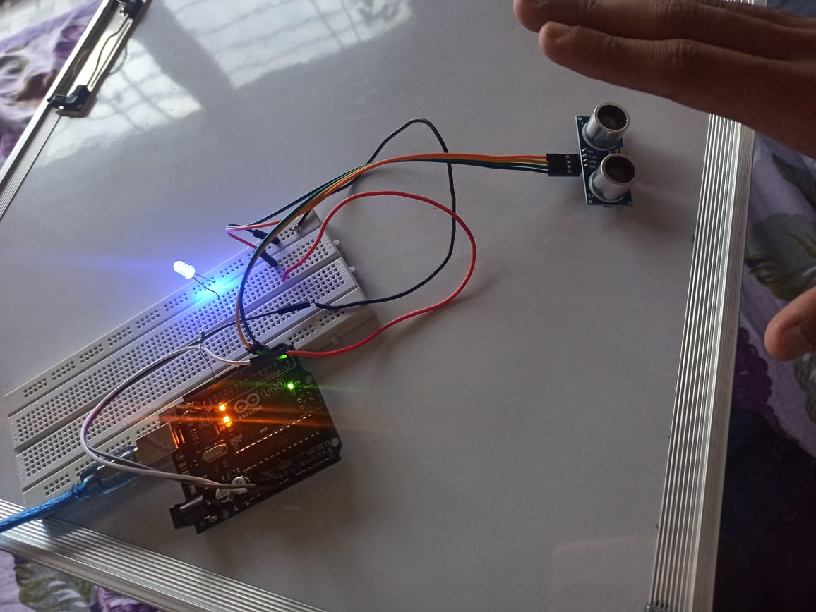
HARDWARE TESTING OF ULTRASONIC SENSOR

Slide 14
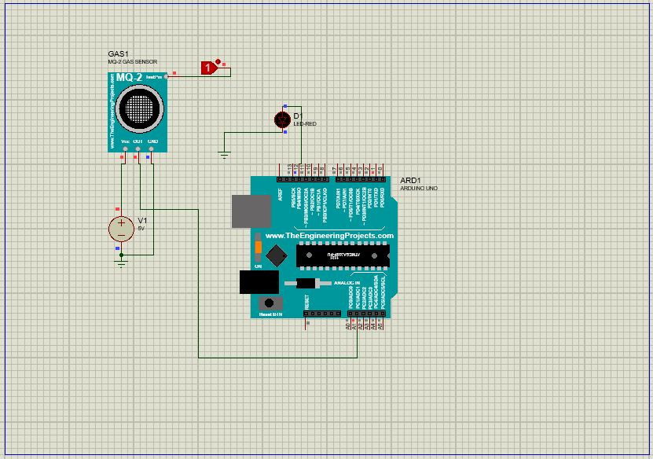
SIMULATION OF GAS SENSOR

Slide 15
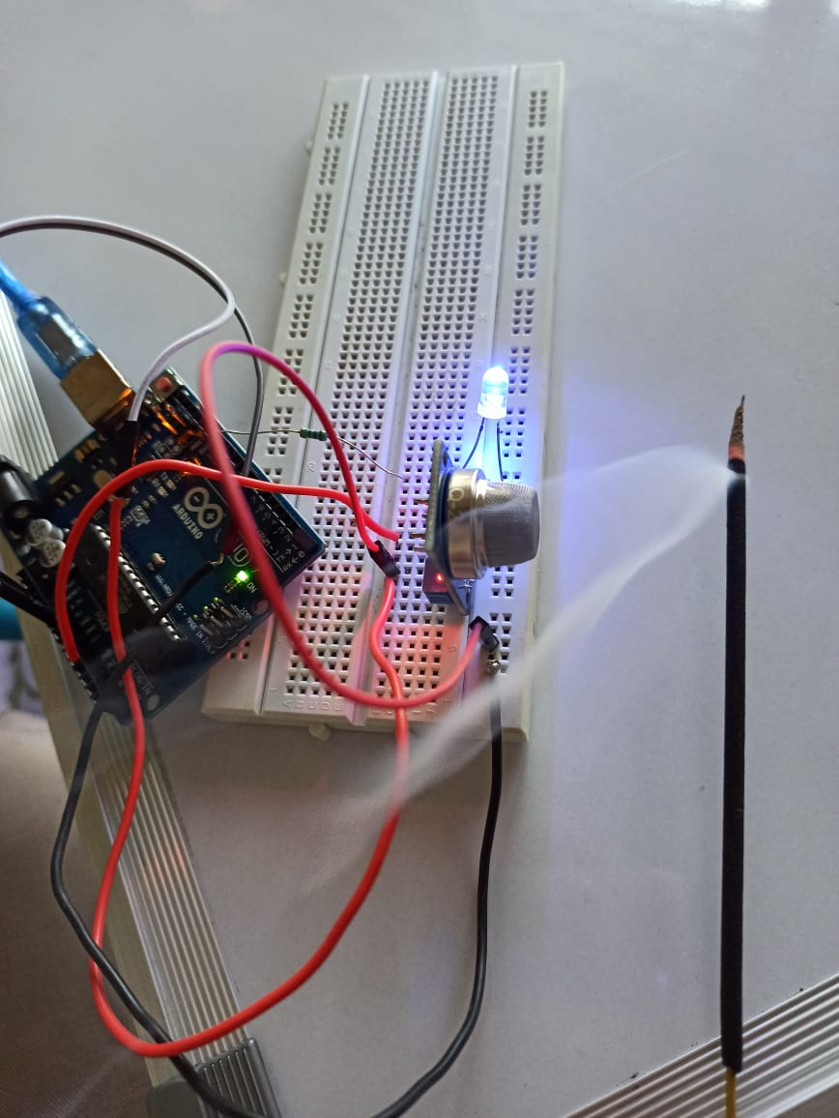
HARDWARE TESTING OF GAS SENSOR

Slide 16
ADVANTAGES
Easy and automated segregation of waste.
Waste level is controllable.
Due to IOT, automatically gives indication to the authorities, when needed.

Slide 17
CHALLENGES
Needs continuous power supply.
Lack of internet facilities in public places.

Slide 18
FUTURE SCOPE
Solar Panels for power supply.
Segregating Electronics was.
Robotic dustbin to drive through to waste recycle plant.

